Slide 1
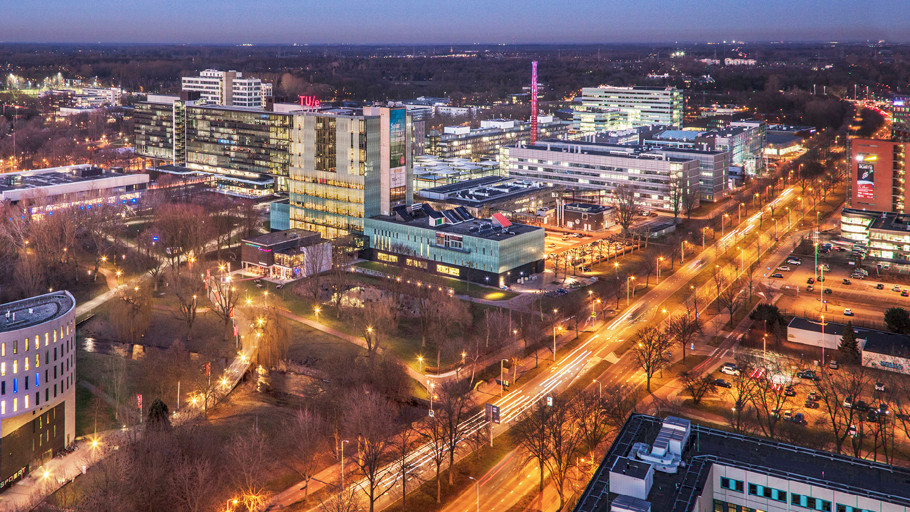
2022 Autonomous Referee – Final Presentation
24 March 2023
PDEng Trainees MSD 2022
1
2022 MSD AutoRef Project
1

Slide 2
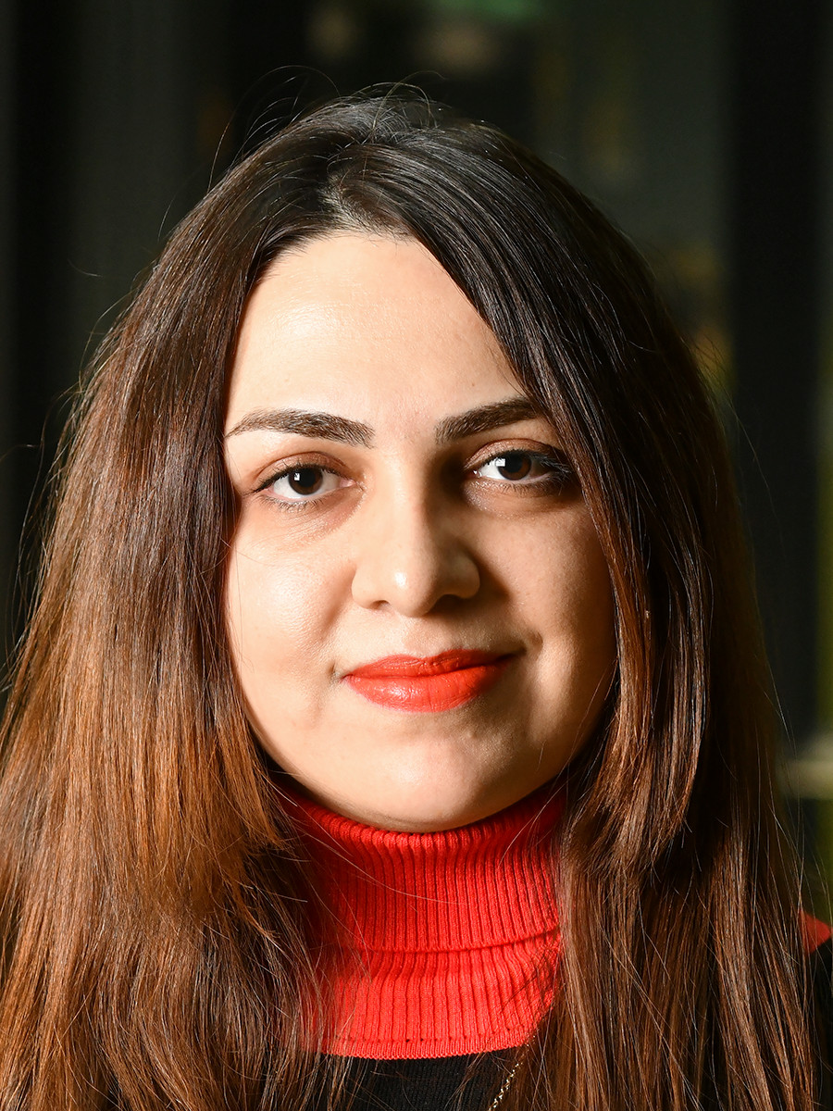
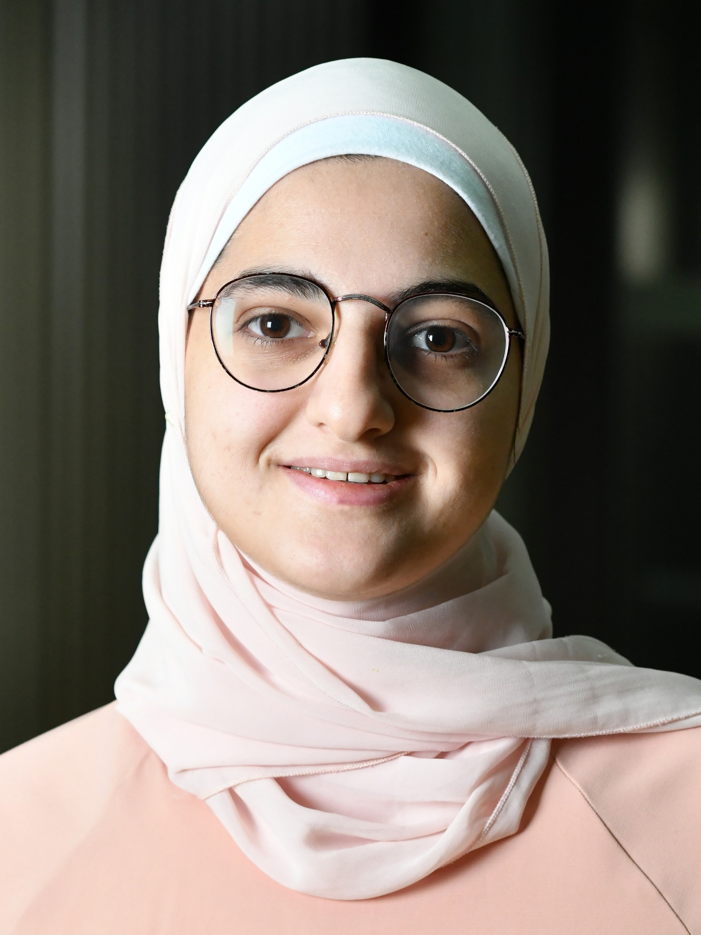
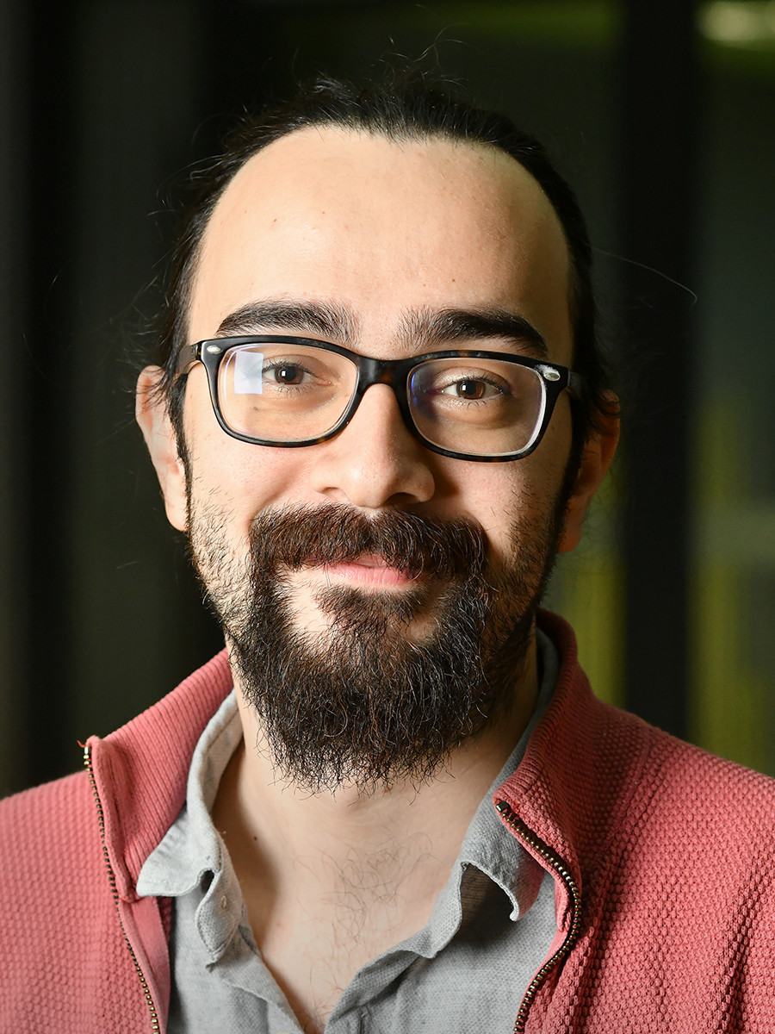
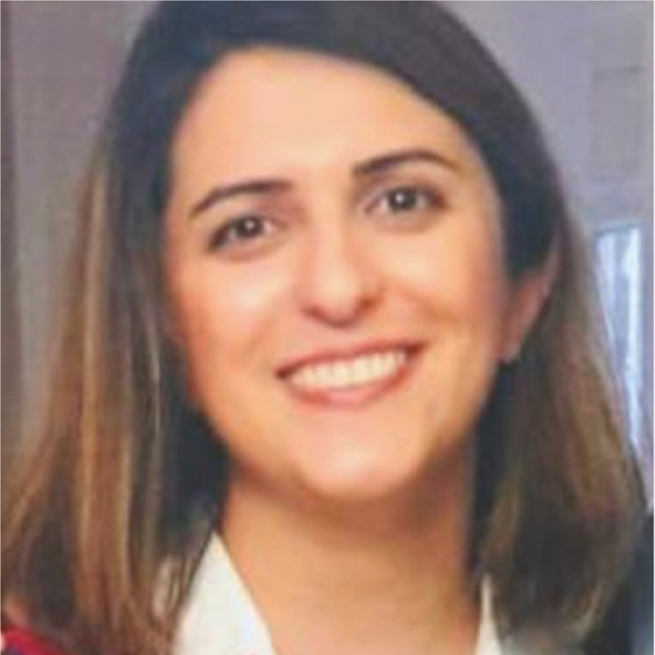
MSD Trainees
Elham Honarvar
PM and Designer
Farah Fadel
TL and Designer
Ahmet Demirel
SA and Designer
Atefeh Dehghannayeri
QM and Designer

Slide 3
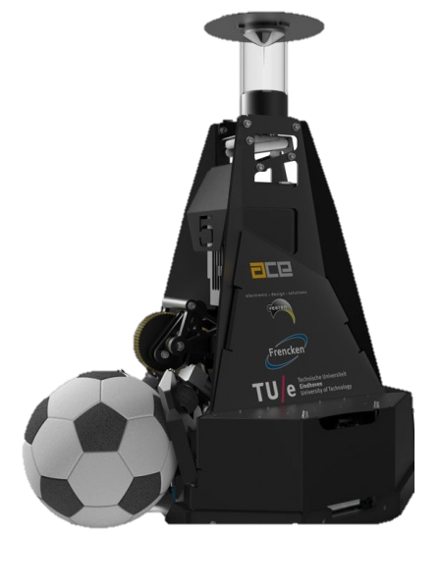
Contents
Motivation
System Thinking Process - Requirement analysis
System architecture
Implementation and Validation
Future work

Slide 4
1 Motivation

Slide 5
Why Autonomous-Referee?
Avoid bias in decision making
1
Help human referee to have complete vision of the field
2
Avoid human error
3
Assist human Referee in rules that are difficult to interpret
4
Help Referee for checking rule procedures
5

Slide 6
2 System Thinking Process

Slide 7
From Needs to Requirements
Stakeholders​ | Needs​ | Requirements​
Legal authorities​ | Following FIFA Law | The system must comply to the standards in latest FIFA law Book.
Next Generation | Sustainability & Flexibility | The system should allow the next generation to use this year's results and be flexible for any adjustment.
Human Referee | Providing the history of the match | The system should store the data, show the logs of the match & evidence of violations when needed.
 | Communicating with auto referee | The system should be able to communicate with the human referee, such as giving feedback and assisting during the match.
Maintainer​ | The maintainer should be able to test and verify the system | The maintenance panel of the system should have a test component for testing the entire system.​
Program Manager | Achieving learning goals | The team members should full fill their responsibilities based on roles assigned.

Slide 8
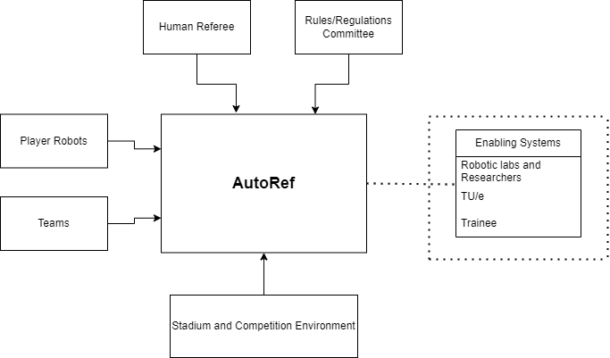
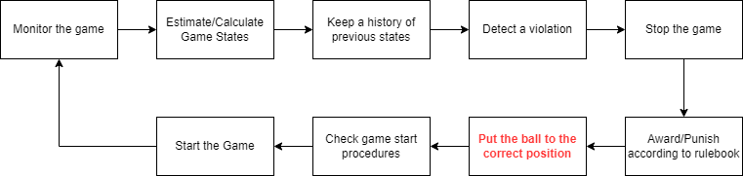
System Thinking Tools
External and Enabling Systems
Mission
Pre-mission | Mission | Post-Mission
System mounting to environment | Check the kick-off procedure | Ensure and handle the data related to the game is safe
Communication with related parties before match (Refbox etc.) | Set time and start the match | Shut Down the system
Turn on the system | Monitor the whole match and game states
 | Record the last position of ball in case of connection with field line
 | Detect rule violation
 | Decision-making algorithm (award and punishment system such as penalty or yellow card)
 | Help human referee if needed
 | Log and show evidence for game calls
 | Stop the game when needed and check procedures before starting again.
 | End match
Process Flow
Notes:
External Systems are defined as the related parties with the AutoRef while it is working such as players and teams during a match etc.
Enabling Systems are defined as the people or organizations that are indirectly related but have mutual interests with the system.

Slide 9
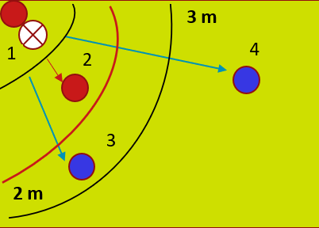
Corner Procedure
The ball is placed inside the corner arc
Players of the corner kick awarded team => radius of 2m
Players of opponent team => radius of 3m

Slide 10

Project Scope
Detect any violation occurring when starting the game with a corner kick within 1 sec with 90% accuracy (true detections)
Performance Requirements
All hardware regarding the AutoRef shall be compatible with MSL organization environment.
AutoRef shall:
Allow users to modify game rule parameters
Be capable of sending/receiving digital ON/OFF signals to/from AutoRef
Record/store game data as well as log history in safe deposit
Acquire data in each 0,04 second and estimate game states max 5 cm for positions
Decide a violation within 1 second
Notes:
WHY we CHOOSE CORNER KICK PROCEDURE?????

Slide 11
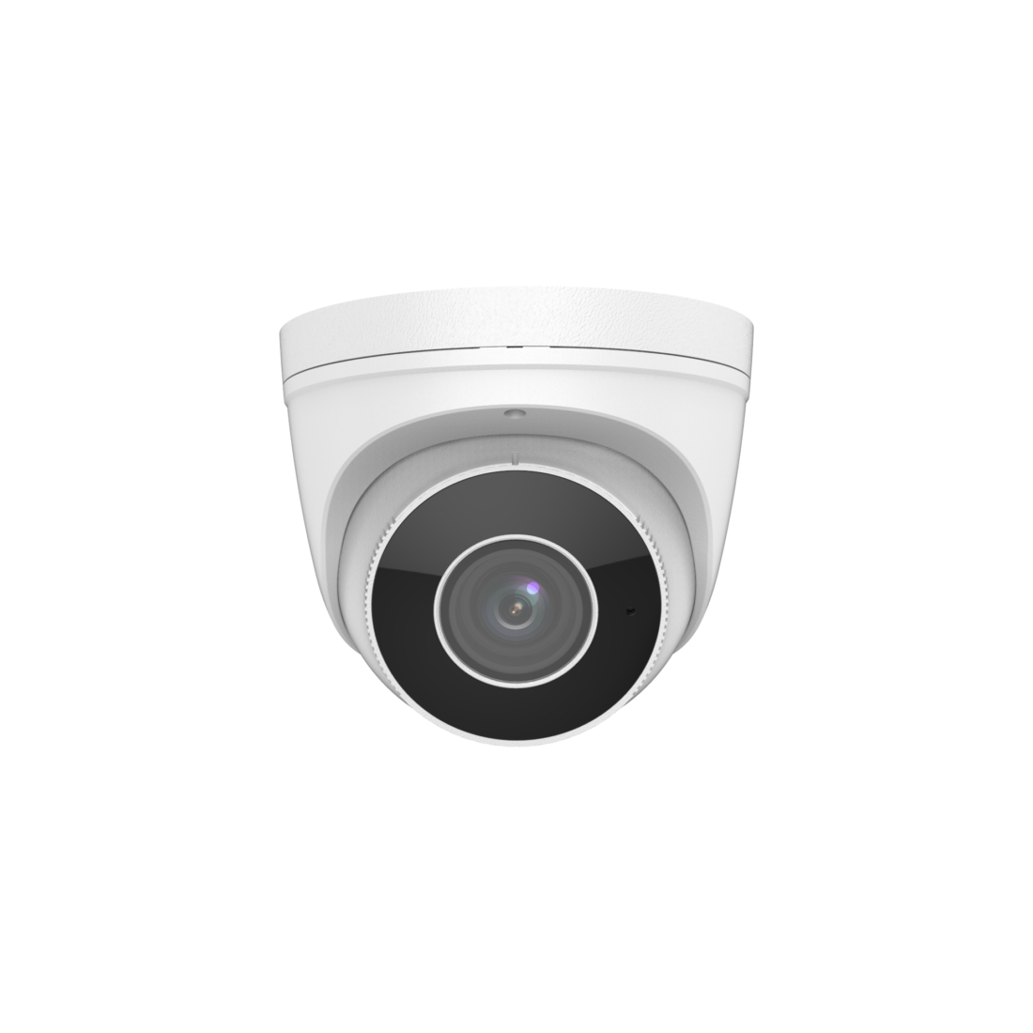
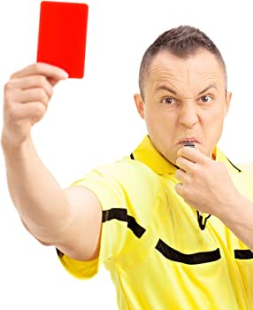

Approach
Proper data acquisition strategy
Officiate the match and detect violations
Validate the algorithm using corner kick procedure
Inform the referee in case of violation
3 m
1
2
4
3
2 m

Slide 12

Challenges
Data Collection
Rule and state interpretation
Perception and sensing in real time
Communication
Integration with existing systems
Adapting to changing conditions

Slide 13
3 System Architecture

Slide 14
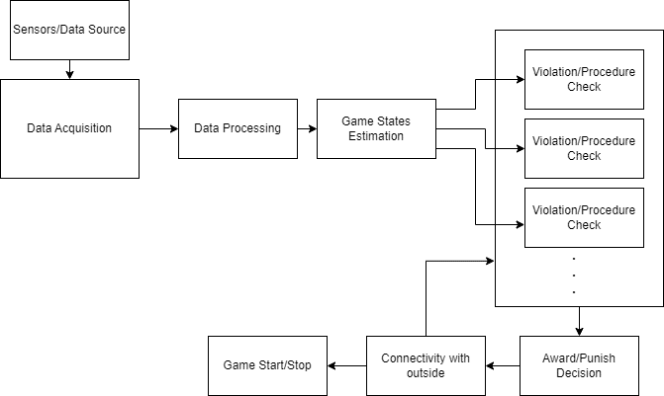
Logical Architecture
Single Point of Failure
Data Acquisition Method and HW
Adaptability to future rule changes
Parallel loops for different rules and procedures
Parametrization – State Estimation

Slide 15
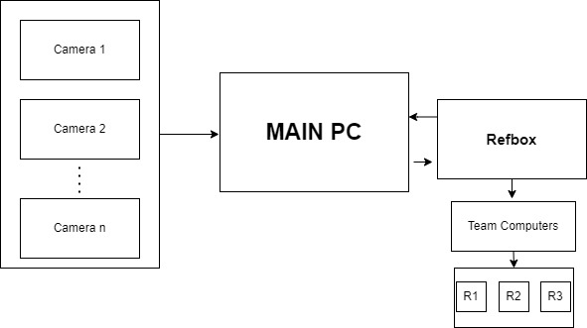
Physical Architecture
Single Point of Failure
Camera has been chosen
Reachable hardware
High TRL
Less complex – known unknows
Inexpensive (If cost involved)
Compatible with personal achievements
Connected to past/future work

Slide 16
4 Implementation and Validation

Slide 17
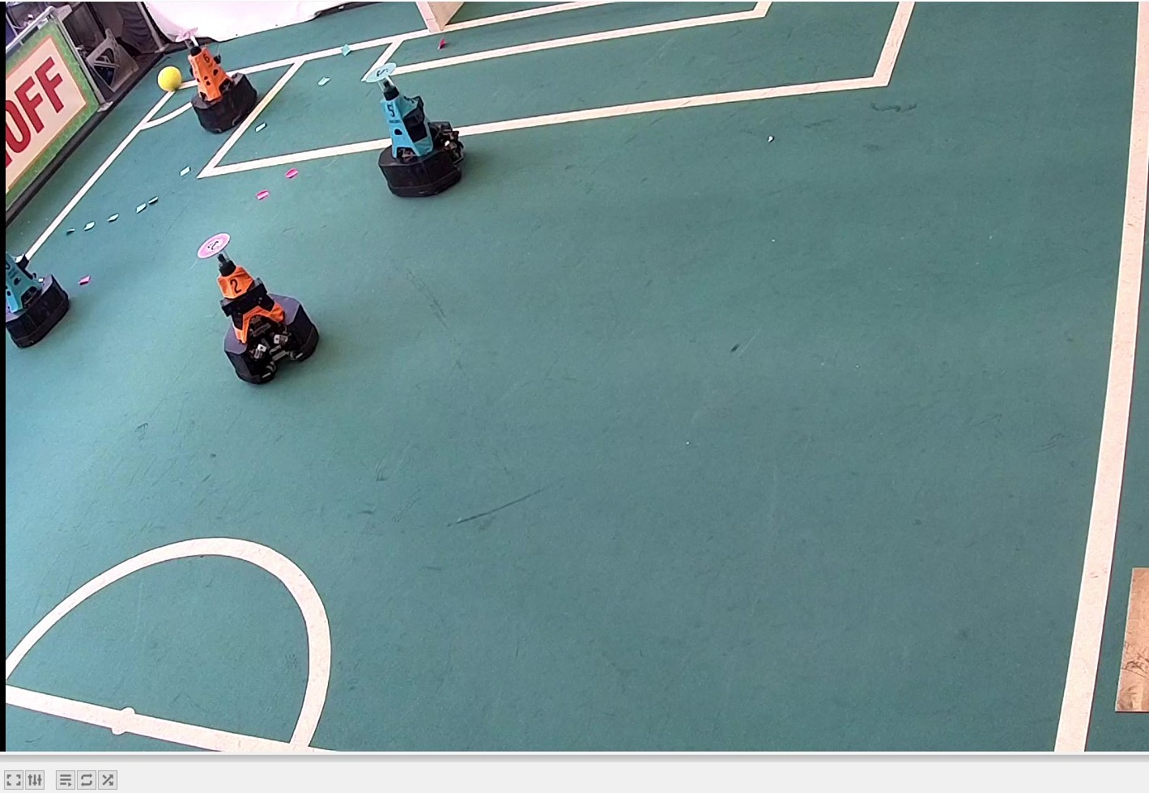
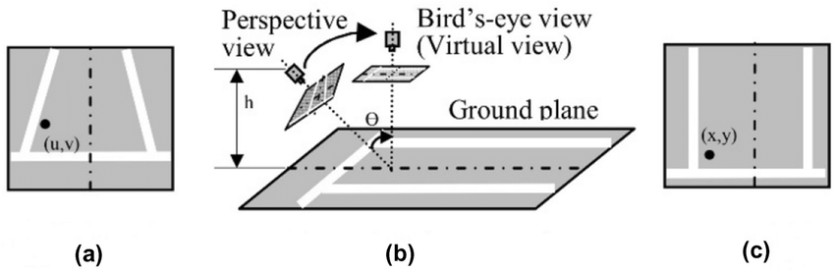
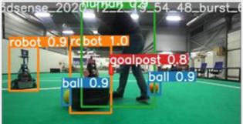
Implementation Details
Decide which camera and which angle to be used
How to Calculate/Tune camera depth and pixel relation parameters
Find a proper ML technique to object detection
Prepare a dataset for training/testing purposes
Notes:
Due to physical constraints, one of the security camera with proper angle has been chosen
Birdseye transformation has been used to transform auxiliary to top view
YOLO v5 is used as ML model
500 frames has been chosen from video recordings
Tilting and Blur are added to prevent overfit (3x imgs)

Slide 18
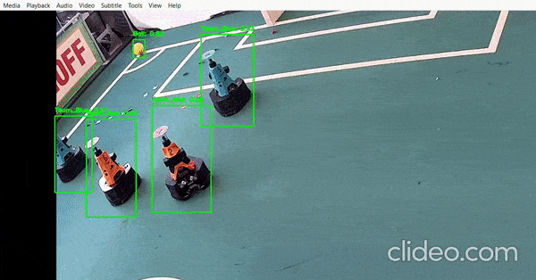
Object Detection algorithm

Slide 19
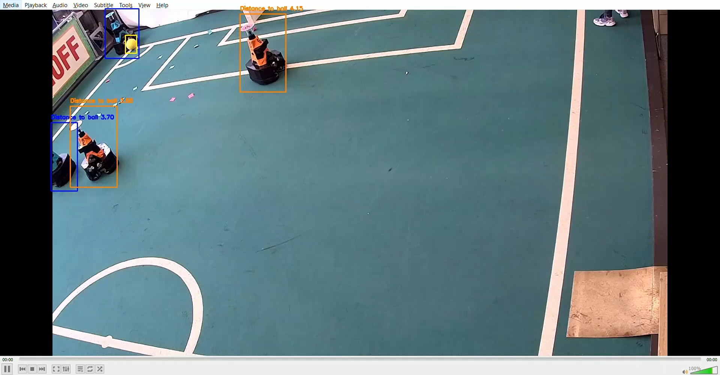
Attacking Team Scenario

Slide 20
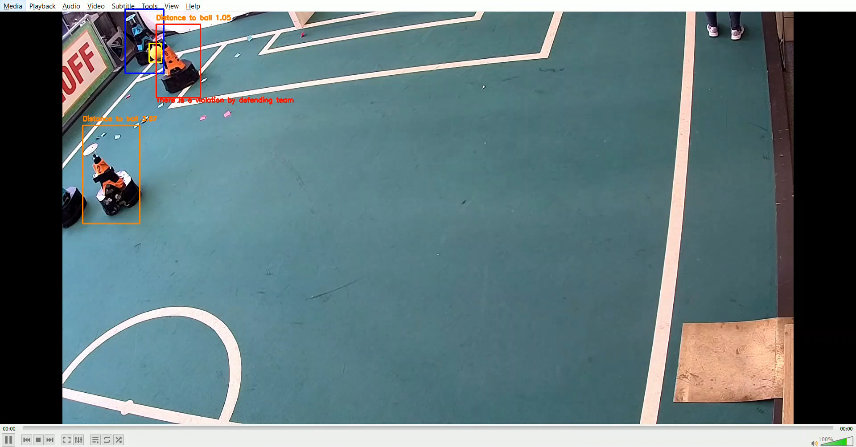
Validation in Defending Team Scenario

Slide 21
Risk Management
Risk | Mitigation Measures
Dataset storage privacy | Transferring the data to local environment
Dataset creating Problem | Improving the dataset, collecting more samples
Camera Communication Problem | Using wired connection
Losing communication between autonomous & human referee | It is out of scoop
Deficient View Angle | Installing more cameras
Environmental Dynamics | Guarantee desired level of lighting

Slide 22
5 Future Work

Slide 23
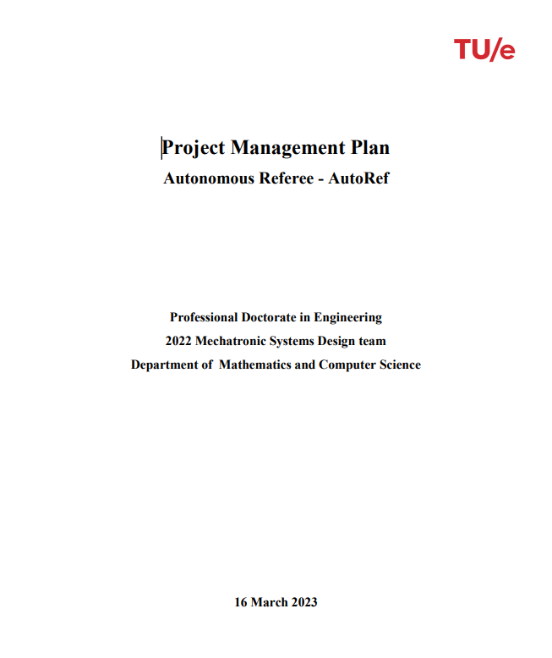

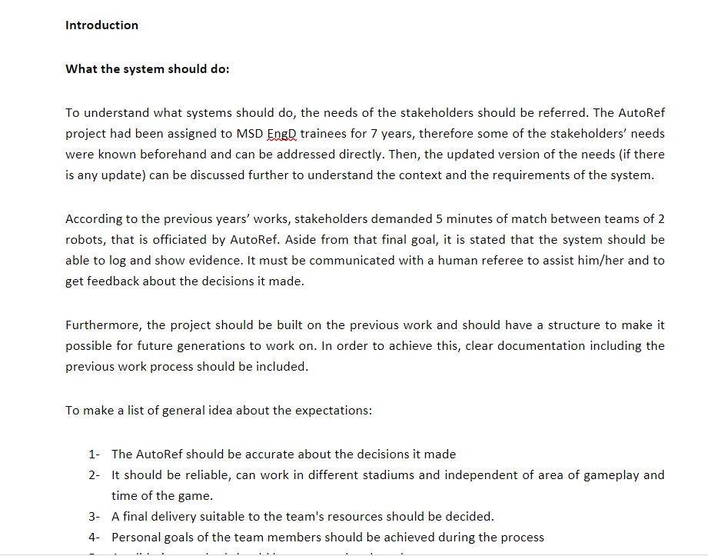
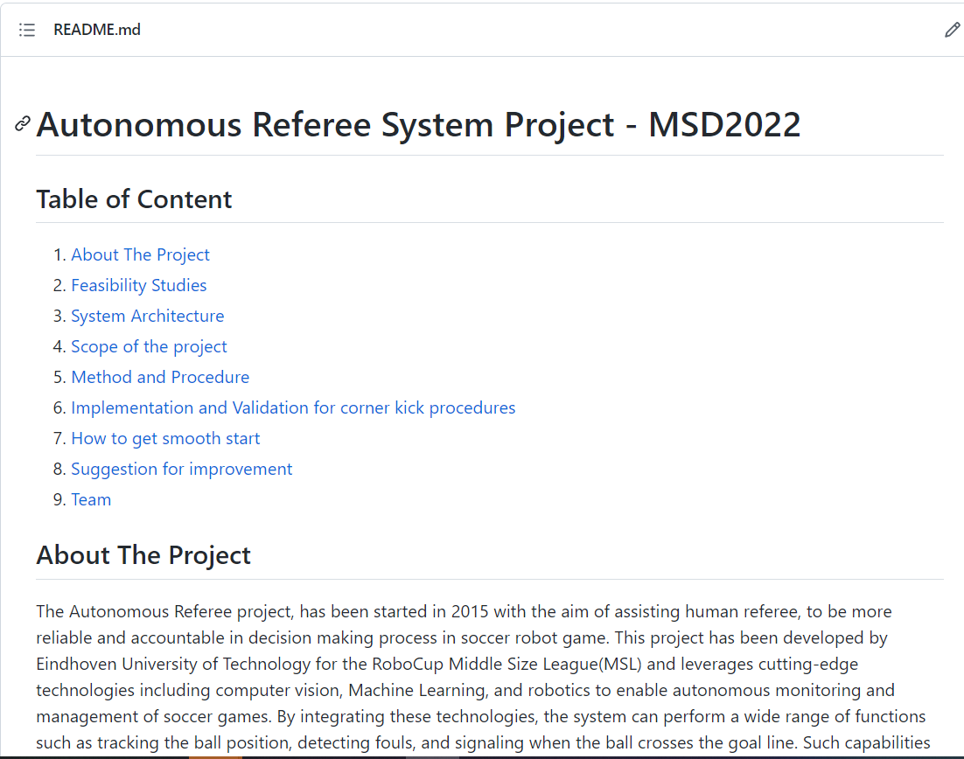
Deliverables
Project Management Plan
Feasibility Analysis Report
System Architecture
GitHub Repository

Slide 24



Future Work
Data Perception
Cognition
Communication
Adjust the predicted model
Generalize the model
Integrate other cameras for data collection
Implement other rules
Optimize the algorithm performance
Apply the algorithm directly from a live stationary camera
Incorporate the communication between AutoRef and Refbox
Execute communication with human referee in real time

Slide 25
Thank you

